Slide 1

Portfolio Construction Through Mixed-Integer Programming
Rasmus Laansalu
Edoardo Tarcisio Visconti
Alessandro Wiget
Enrico Pescara

Slide 2
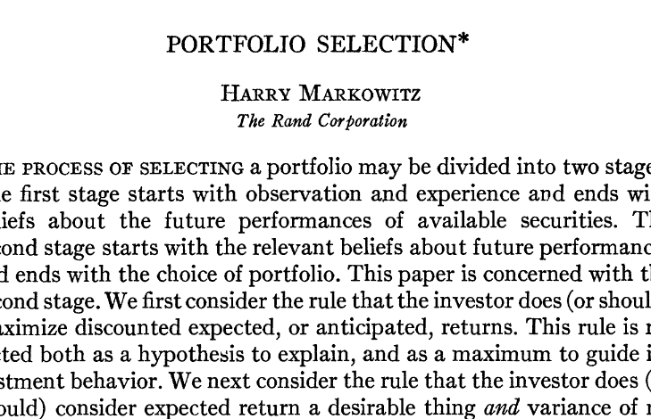
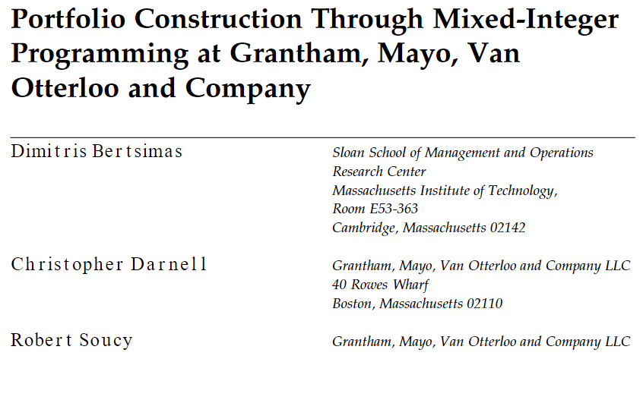

OUR
OBJECTIVE
FUNCTION
MIP
APPROACH
OUR
OBJECTIVE
FUNCTION

Slide 3
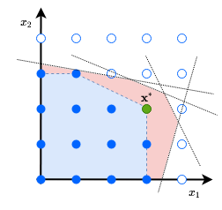
OUR
OBJECTIVE
FUNCTION
Implementing portfolio construction
Complications that the classical theory does not address
MIP
APPROACH
Parameters to consider:
number of different stocks
number of transactions
transaction fees
OUR
OBJECTIVE
FUNCTION
COMPLETE
PROBLEM
FORMULATION

Slide 4
OUR
OBJECTIVE
FUNCTION
MIP
APPROACH
We set a target portfolio wT monthly:
w0 is the current portfolio
wF will be the desirable portfolio to own after rebalancing monthly
Our objective function is formulated according to:
closeness to target portfolio wT
exposure to different economic sectors close to that of the wT
small # of names
small # of transactions
high return
high liquidity
low transaction costs
OUR
OBJECTIVE
FUNCTION
COMPLETE
PROBLEM
FORMULATION
CLOSENESS TO MARKET
PORTFOLIO

Slide 5
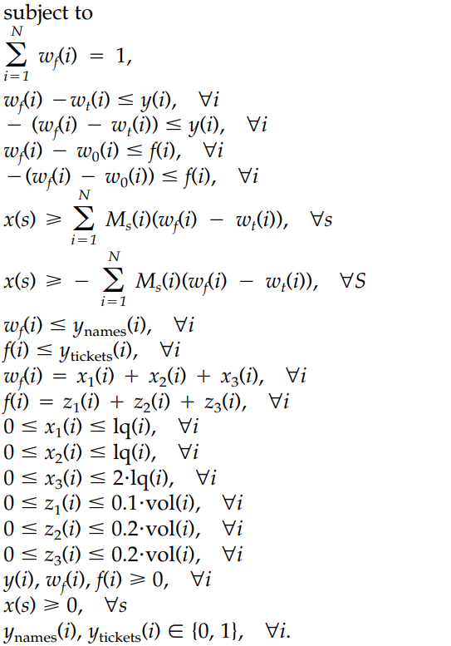
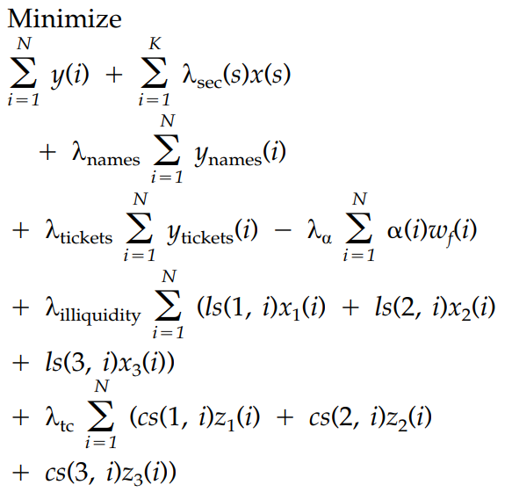
LQ AND VOL
CHOICE
OF
LAMBDA
IMPLEMENTATION
LAMBDA
=
0
THE
MARKET
PORTFOLIO
MIP
APPROACH
BASELINE
STRATEGY
OUR
OBJECTIVE
FUNCTION
SUMMARY
COMPLETE
PROBLEM
FORMULATION
CLOSENESS TO MARKET
PORTFOLIO
LOW
TRANSACTION
COST
EXPOSURE
TO
DIFFERENT SECTORS
HIGH
LIQUIDITY
HIGH
RETURN
NUMBER
OF
STOCKS
NUMBER
OF
TRANSACTIONS

Slide 6
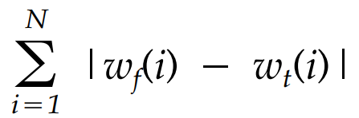
LQ AND VOL
CHOICE
OF
LAMBDA
IMPLEMENTATION
LAMBDA
=
0
THE
MARKET
PORTFOLIO
OUR
OBJECTIVE
FUNCTION
BASELINE
STRATEGY
COMPLETE
PROBLEM
FORMULATION
It is desirable for the portfolio wF
to be as close as possible to wT:
SUMMARY
CLOSENESS TO MARKET
PORTFOLIO
EXPOSURE
TO
DIFFERENT SECTORS
LOW
TRANSACTION
COST
NUMBER
OF
NAMES
HIGH
LIQUIDITY
NUMBER
OF
TRANSACTIONS
HIGH
RETURN

Slide 7
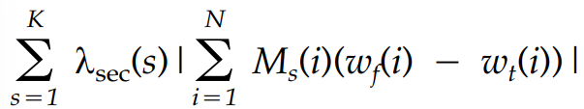
LQ AND VOL
CHOICE
OF
LAMBDA
IMPLEMENTATION
LAMBDA
=
0
THE
MARKET
PORTFOLIO
COMPLETE
PROBLEM
FORMULATION
BASELINE
STRATEGY
CLOSENESS TO MARKET
PORTFOLIO
It is desirable to have exposure to different sectors
between wT and wF to be as close as possible.
SUMMARY
EXPOSURE
TO
DIFFERENT SECTORS
NUMBER
OF
NAMES
Ms(i) binary index denoting membership of stock i in sector s
Lambda_sec(s) is a user-specified penalty for sector s.
LOW
TRANSACTION
COST
NUMBER
OF
TRANSACTIO-NS
HIGH
RETURN
HIGH
LIQUIDITY

Slide 8
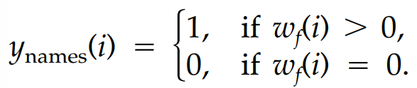
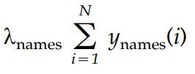
LQ AND VOL
CHOICE
OF
LAMBDA
IMPLEMENTATION
LAMBDA
=
0
THE
MARKET
PORTFOLIO
CLOSENESS TO MARKET
PORTFOLIO
BASELINE
STRATEGY
EXPOSURE
TO
DIFFERENT SECTORS
We define:
Requirement captured by:
We want to have a small amount of Names (stocks) in the portfolio to minimize:
custodial fees
transaction costs
SUMMARY
NUMBER
OF
NAMES
NUMBER
OF
TRANSACTIO-NS
LOW
TRANSACTION
COST
HIGH
RETURN
HIGH
LIQUIDITY

Slide 9
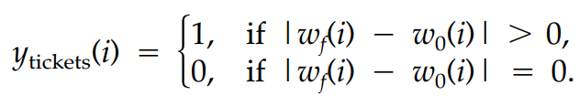
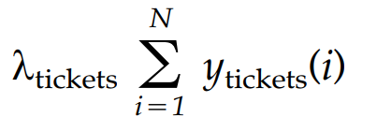
LQ AND VOL
CHOICE
OF
LAMBDA
IMPLEMENTATION
LAMBDA
=
0
THE
MARKET
PORTFOLIO
EXPOSURE
TO
DIFFERENT SECTORS
BASELINE
STRATEGY
NUMBER
OF
NAMES
We define:
Requirement captured by:
Number of transactions needs to be kept low,
to minimize custodial fees and transaction costs
NUMBER
OF
TRANSACTIO-NS
HIGH
RETURN
HIGH
LIQUIDITY
LOW
TRANSACTION
COST
SUMMARY

Slide 10
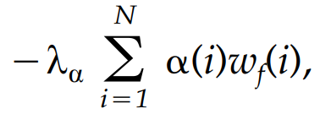
LQ AND VOL
CHOICE
OF
LAMBDA
IMPLEMENTATION
LAMBDA
=
0
THE
MARKET
PORTFOLIO
NUMBER
OF
NAMES
BASELINE
STRATEGY
NUMBER
OF
TRANSACTIO-NS
Requirement captured by:
α(i) is the expected return of stock i ^{(*)}
The sign is negative is because of the overall objective of minimization
^{(*)} We estimated α(i) by taking the mean return of stock i for each month
HIGH
RETURN
HIGH
LIQUIDITY
LOW
TRANSACTION
COST
SUMMARY

Slide 11
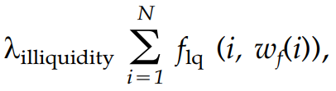
NUMBER
OF
TRANSACTIO-NS
HIGH
RETURN
Illiquidity term is captured by:
HIGH
LIQUIDITY
LAMBDA
=
0
LOW
TRANSACTION
COST
CHOICE
OF
LAMBDA
SUMMARY
LQ AND VOL
IMPLEMENTATION
BASELINE
STRATEGY
THE
MARKET
PORTFOLIO

Slide 12
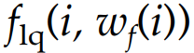
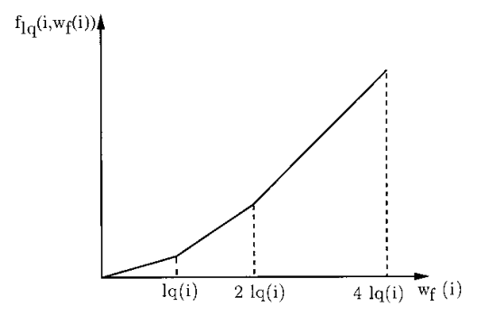
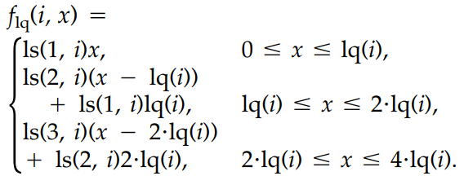
NUMBER
OF
TRANSACTIONS
HIGH
RETURN
We want high liquidity aka low illiquidity. In particular
As the position in a stock increases, it is harder and thus more expensive to trade it.
A piece-wise linear convex function captures illiquidity of stock.
For every stock i there is an illiquidity inxed lq(i)
s.t. the illiquidity function:
HIGH
LIQUIDITY
LAMBDA
=
0
LOW
TRANSACTION
COST
CHOICE
OF
LAMBDA
SUMMARY
LQ AND VOL
IMPLEMENTATION
BASELINE
STRATEGY
THE
MARKET
PORTFOLIO

Slide 13
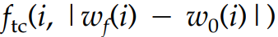
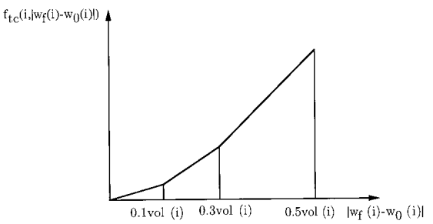
HIGH
RETURN
HIGH
LIQUIDITY
It is desirable to minimize total transaction costs.
Higher the daily volume of a stock traded, the more transaction costs increase because portfolio trades have an impact on the market.
The transaction cost from trading stock i is captured by a piecewise linear convex function:
LOW
TRANSACTION
COST
SUMMARY
BASELINE
STRATEGY
LAMBDA
=
0
THE
MARKET
PORTFOLIO
CHOICE
OF
LAMBDA
IMPLEMENTATION
LQ AND VOL

Slide 14
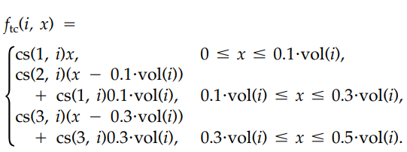
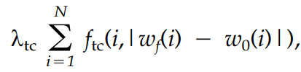
HIGH
RETURN
HIGH
LIQUIDITY
Function defined by:
LOW
TRANSACTION
COST
The transaction cost consideration is captured by:
SUMMARY
BASELINE
STRATEGY
LAMBDA
=
0
THE
MARKET
PORTFOLIO
CHOICE
OF
LAMBDA
IMPLEMENTATION
LQ AND VOL

Slide 15
HIGH
LIQUIDITY
LOW
TRANSACTION
COST
The model uses various penalties, denoted by lambda; they capture the relative importance of the various objectives.
We choose penalties trying to focus our attention on the different characteristics considered.
If we consider a characteristic of the portfolio unsatisfactory, we increase its corresponding penalty.
SUMMARY
BASELINE
STRATEGY
THE
MARKET
PORTFOLIO
LAMBDA
=
0
CHOICE
OF
LAMBDA
IMPLEMENTATION
LQ AND VOL

Slide 16
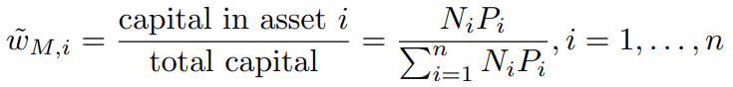
LOW
TRANSACTION
COST
SUMMARY
We simulated the market portfolio
Market portfolio weights:
According to Markowitz’s theory, every efficient portfolio lies on the CML and therefore can be built as a combination of a risk-free asset and the market portfolio.
Therefore, every profile of risk can be satisfied
BASELINE
STRATEGY
THE
MARKET
PORTFOLIO
IMPLEMEN-TATION
LQ AND VOL
CHOICE
OF
LAMBDA
LAMBDA
=
0

Slide 17
SUMMARY
BASELINE
STRATEGY
The market portfolio evolves constantly but our portfolio changes monthly.
At the end of every month, our portfolio tries to replicate the current market portfolio
Room for further improvements: which is the best target every month?
We chose the market portfolio at the moment of recalibration but one can choose the (weighted) average during the last month
THE
MARKET
PORTFOLIO
IMPLEMEN-TATION
LQ and VOL
CHOICE
OF
LAMBDA
LAMBDA
=
0

Slide 18
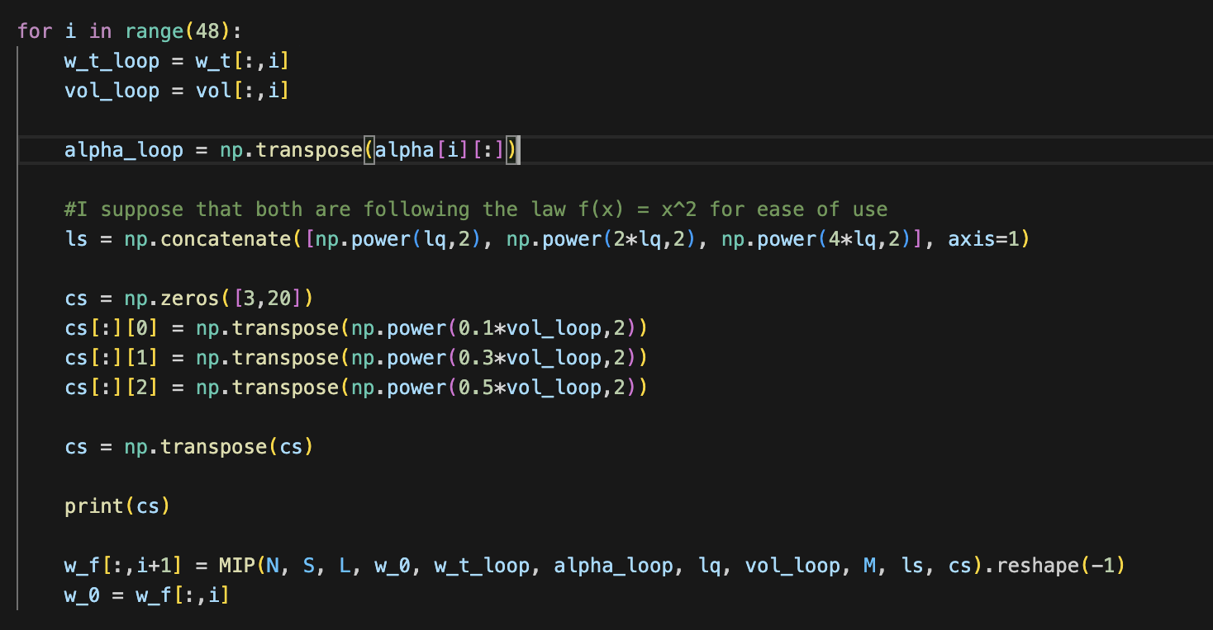
BASELINE
STRATEGY
THE
MARKET
PORTFOLIO
We have simulated a market of 20 stocks (based on the CSVs) and we computed the weights (wT) of the market portfolio daily (multiplying the price of a stock by the number of shares).
Every month we evaluate: the weights target the portfolio, the volume of a stock, and the return of every stock (as the average return in the month).
IMPLEMEN-TATION
LQ and VOL
CHOICE
OF λ
LAMBDA
=
0

Slide 19
THE
MARKET
PORTFOLIO
IMPLEMEN-TATION
How did we make those assumptions?
Lq = ask-bid (doesn’t change over time in our model)
Vol = averageVolLast10Days/averageVolWholePeriod (changes every month)
What does it mean to choose a more convex function than another?
The bigger the weight of a stock the more illiquid it becomes, this pushes for more diverse portfolios
We chose x^2 as a convex function
How does this really affect the model?
It doesn't affect the model as it is, because we are considering only medium to large-cap stocks, if we included other more illiquid assets it would affect the model
LQ and VOL
CHOICE
OF λ
λ = 0

Slide 20
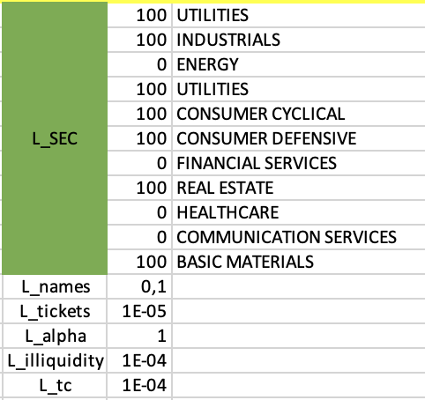
IMPLEMEN-TATION
LQ and VOL
Everyone has is own choice of lamba according to his situation.
Some choices are too big and make the objective function unbalanced
CHOICE
OF λ
We modified the lambdas from the excel file to experiment different objective functions
and different solutions
λ = 0
λ = 0
WITHOUT
CONSTRAIN-TS
OUR
OBJECTIVE
FUNCTION

Slide 21
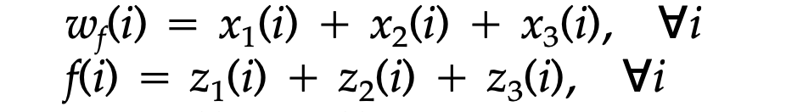
LQ and VOL
CHOICE
OF λ
Is the only purpose of our portfolio to replicate the target?
Yes but still there are some active constraints related to volatility and transaction cost
If we eliminate such constraints our final portfolio shadows the target portfolio (with a one-month delay)
λ = 0
λ = 0
WITHOUT
CONSTRAIN-TS
λ = 0
WITH
CONSTRAI-NTS
OUR
OBJECTIVE
FUNCTION

Slide 22
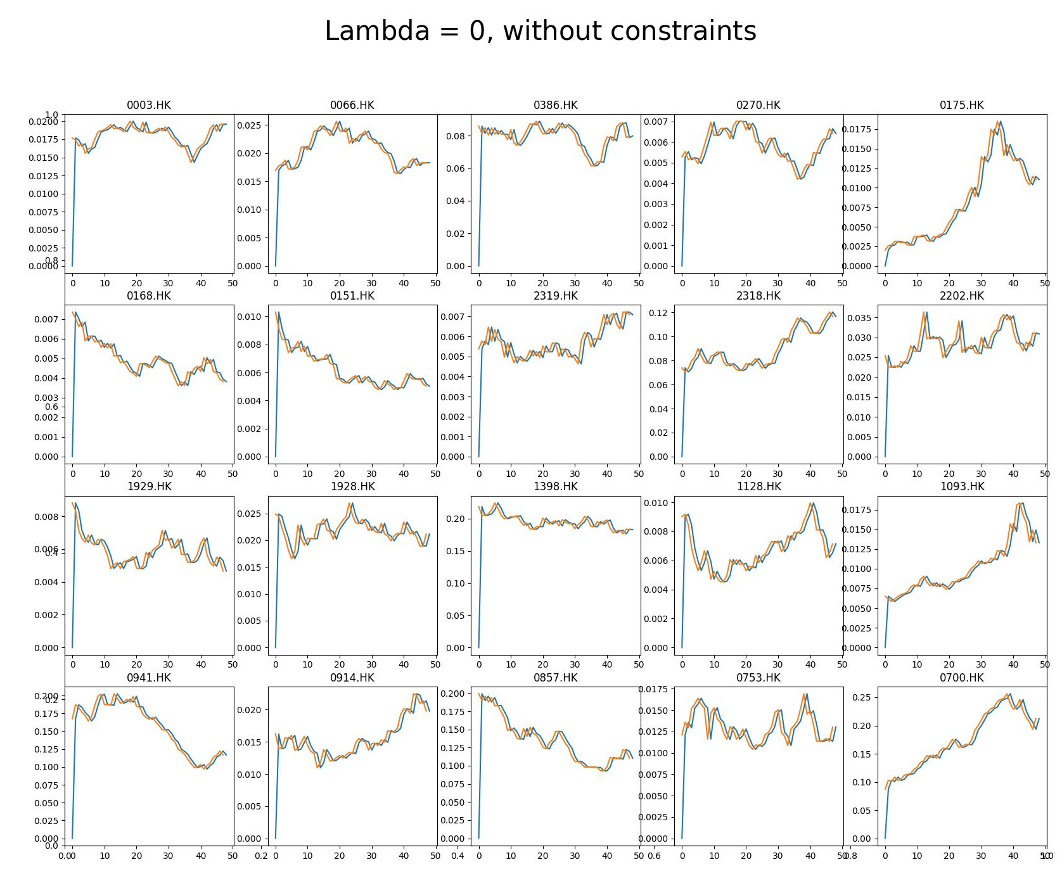
CHOICE
OF λ
λ = 0
λ = 0
WITHOUT
CONSTRAIN-TS
λ = 0
WITH
CONSTRAI-NTS
λα = 1

Slide 23
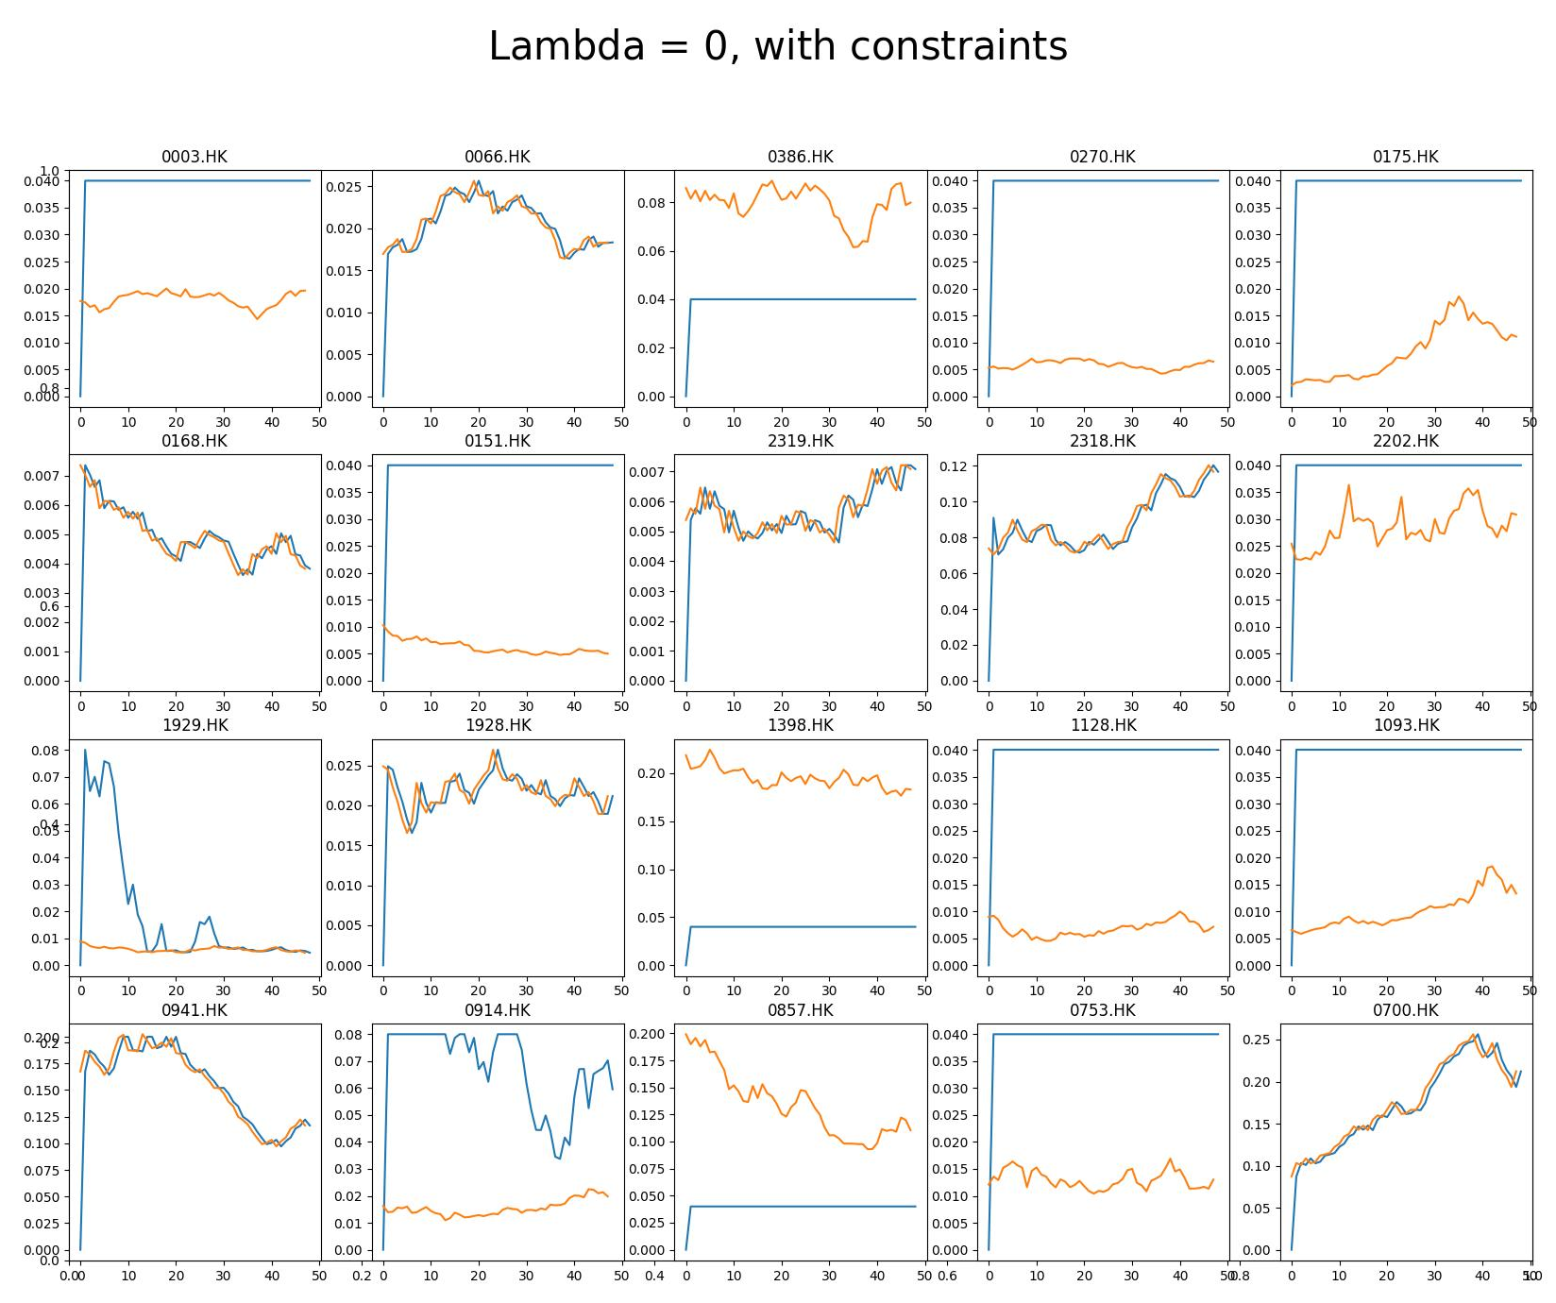
λ = 0
λ = 0
WITHOUT
CONSTRAIN-TS
λ = 0
WITH
CONSTRAI-NTS
λα = 1
λnames = 0.1

Slide 24
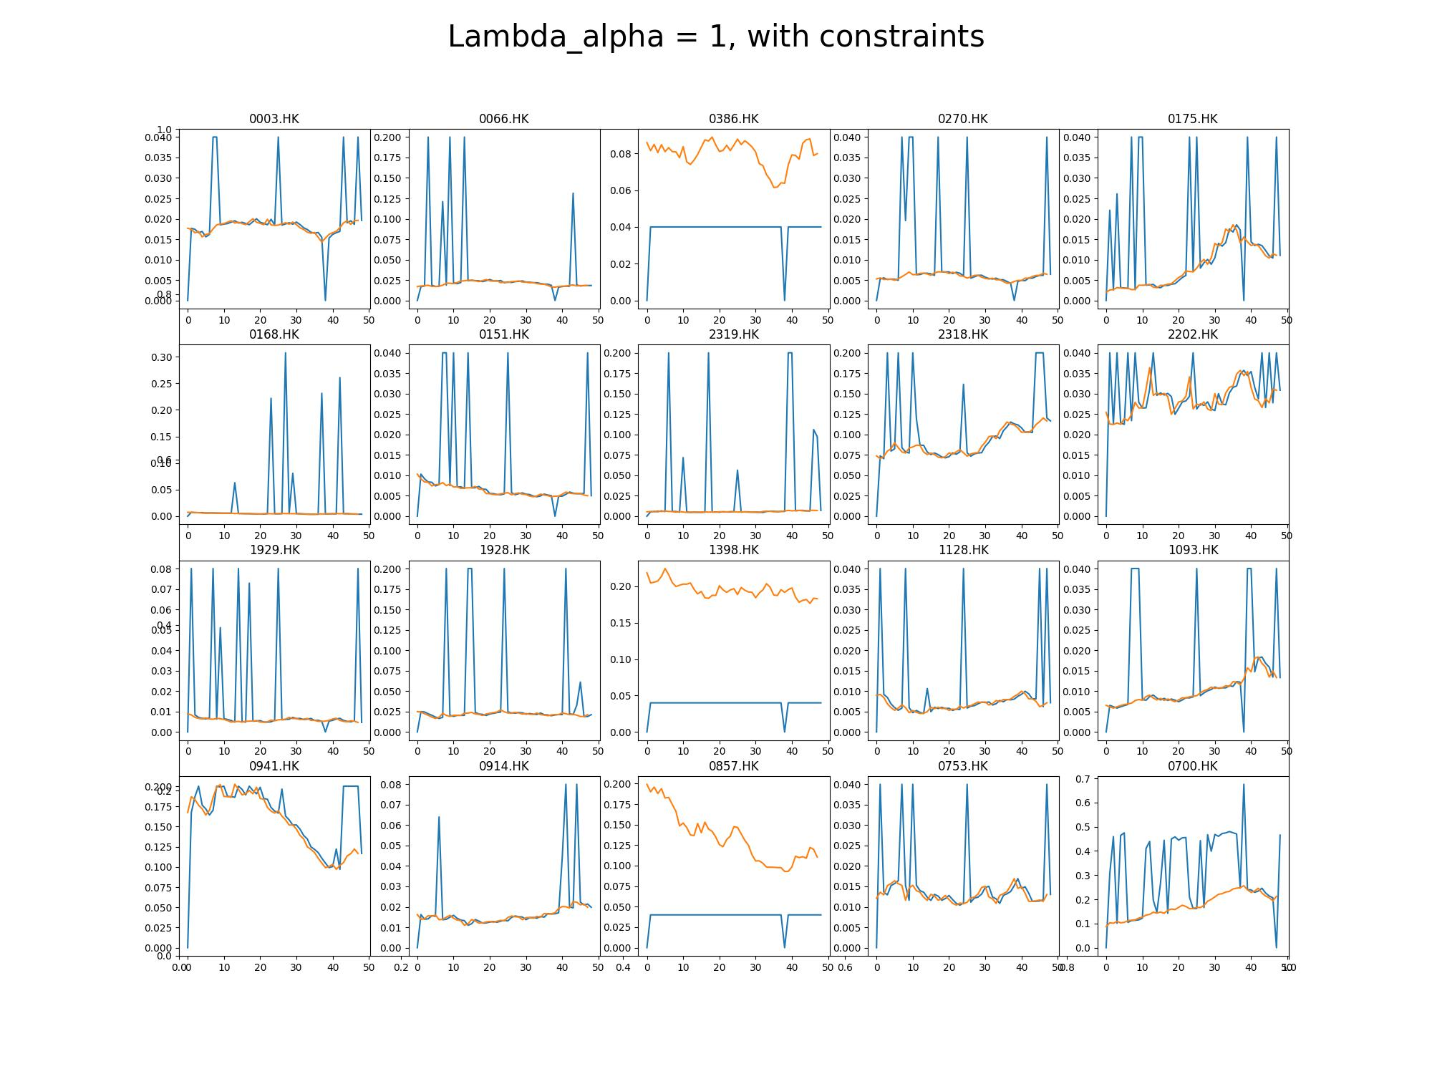
λ = 0
WITHOUT
CONSTRAIN-TS
λ = 0
WITH
CONSTRAI-NTS
After testing we found that λα = 1 is a reasonable size for the parameter
λα = 1
λnames = 0.1
λilly and λ_{tc}

Slide 25
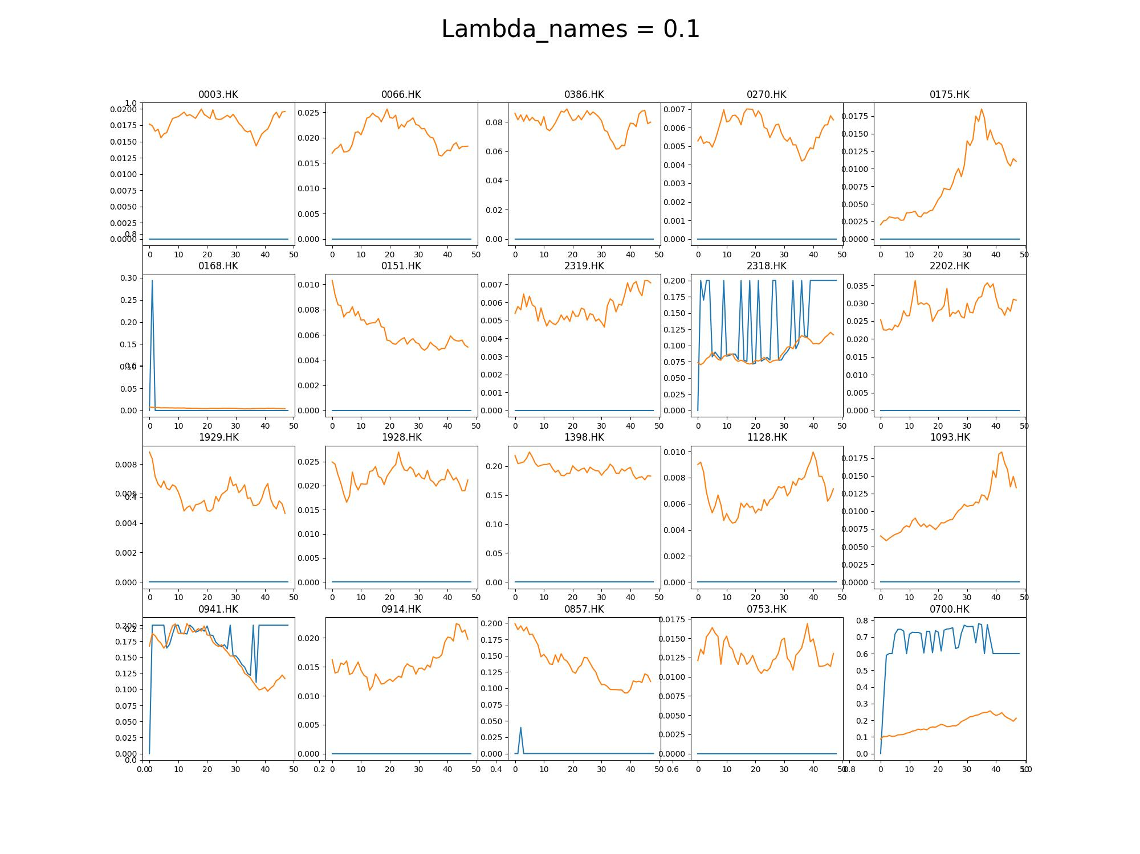
λ = 0
WITH
CONSTRAI-NTS
λα = 1
Choosing λ_{names} = 0.1 gives too much importance to having fewer stocks.
λnames = 0.1
λilly and λ_{tc}
λsec

Slide 26
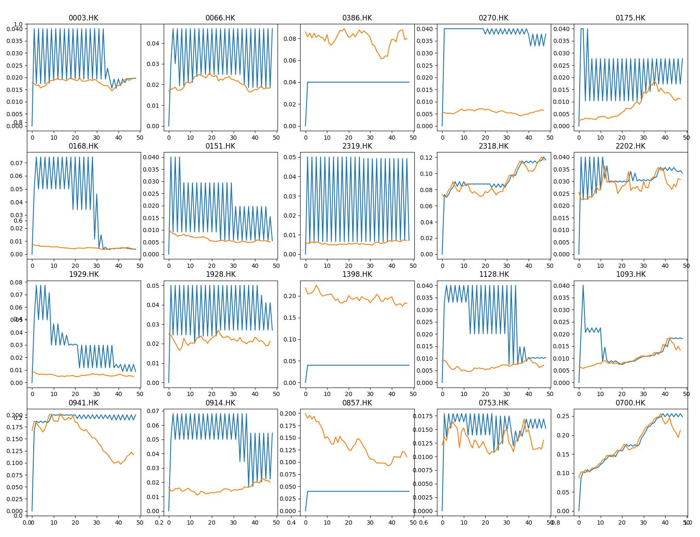
λα = 1
λnames = 0.1
With λ_{illy}=1e-4, we focus on the stocks that have high liquidity, so the weights of these stocks are heavier than the others.
Choosing λ_{tc}=0.1, we don’t give too much importance to doing few transactions, and it can be seen by the high frequency of changes on portfolio weights
λilly and λ_{tc}
λ_{sec}
Example Portfolio

Slide 27
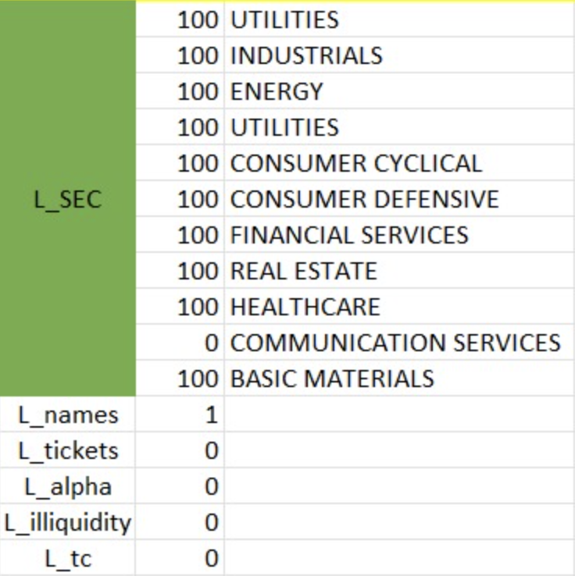
λnames = 1
λilly and λ_{tc}
Now we chose to have a reduced number of names and to prioritize stokes from “Communication services”: as a result, stocks like “0700.HK” make up to 50% of the portfolio.
This is against the idea of shadowing the target portfolio but shows the goodness of the algorithm
λ_{sec}
Example Portfolio
OUR
OBJECTIVE
FUNCTION

Slide 28
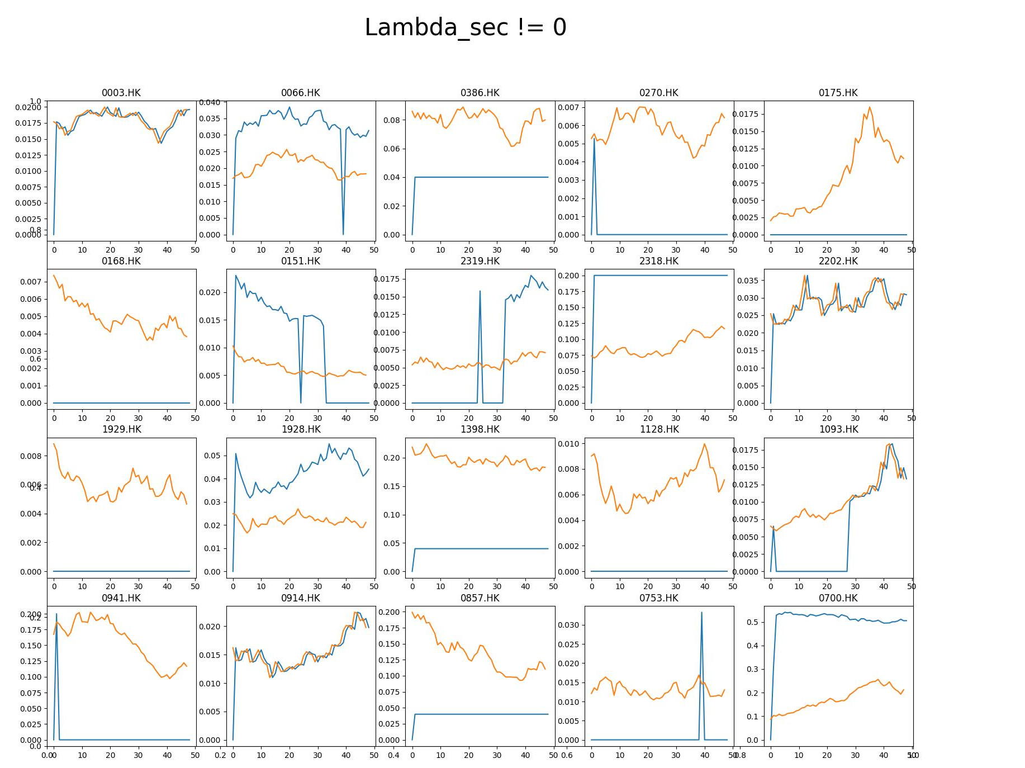
λnames = 0.1
λilly and λ_{tc}
λ_{sec}
Example Portfolio
OUR
OBJECTIVE
FUNCTION

Slide 29
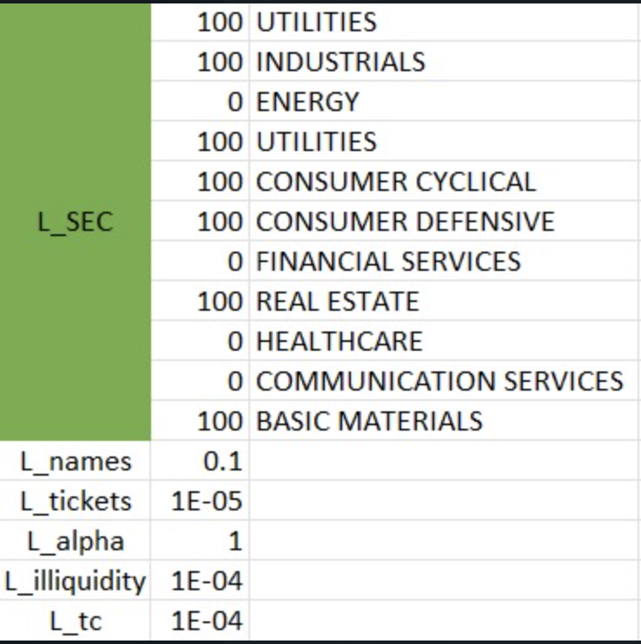
λilly and λ_{tc}
λsec
Idea of possible lambdas for a portfolio: we shadow the market portfolio and try to reduce the number of names and of transactions and their size.
Example Portfolio
OUR
OBJECTIVE
FUNCTION

Slide 30
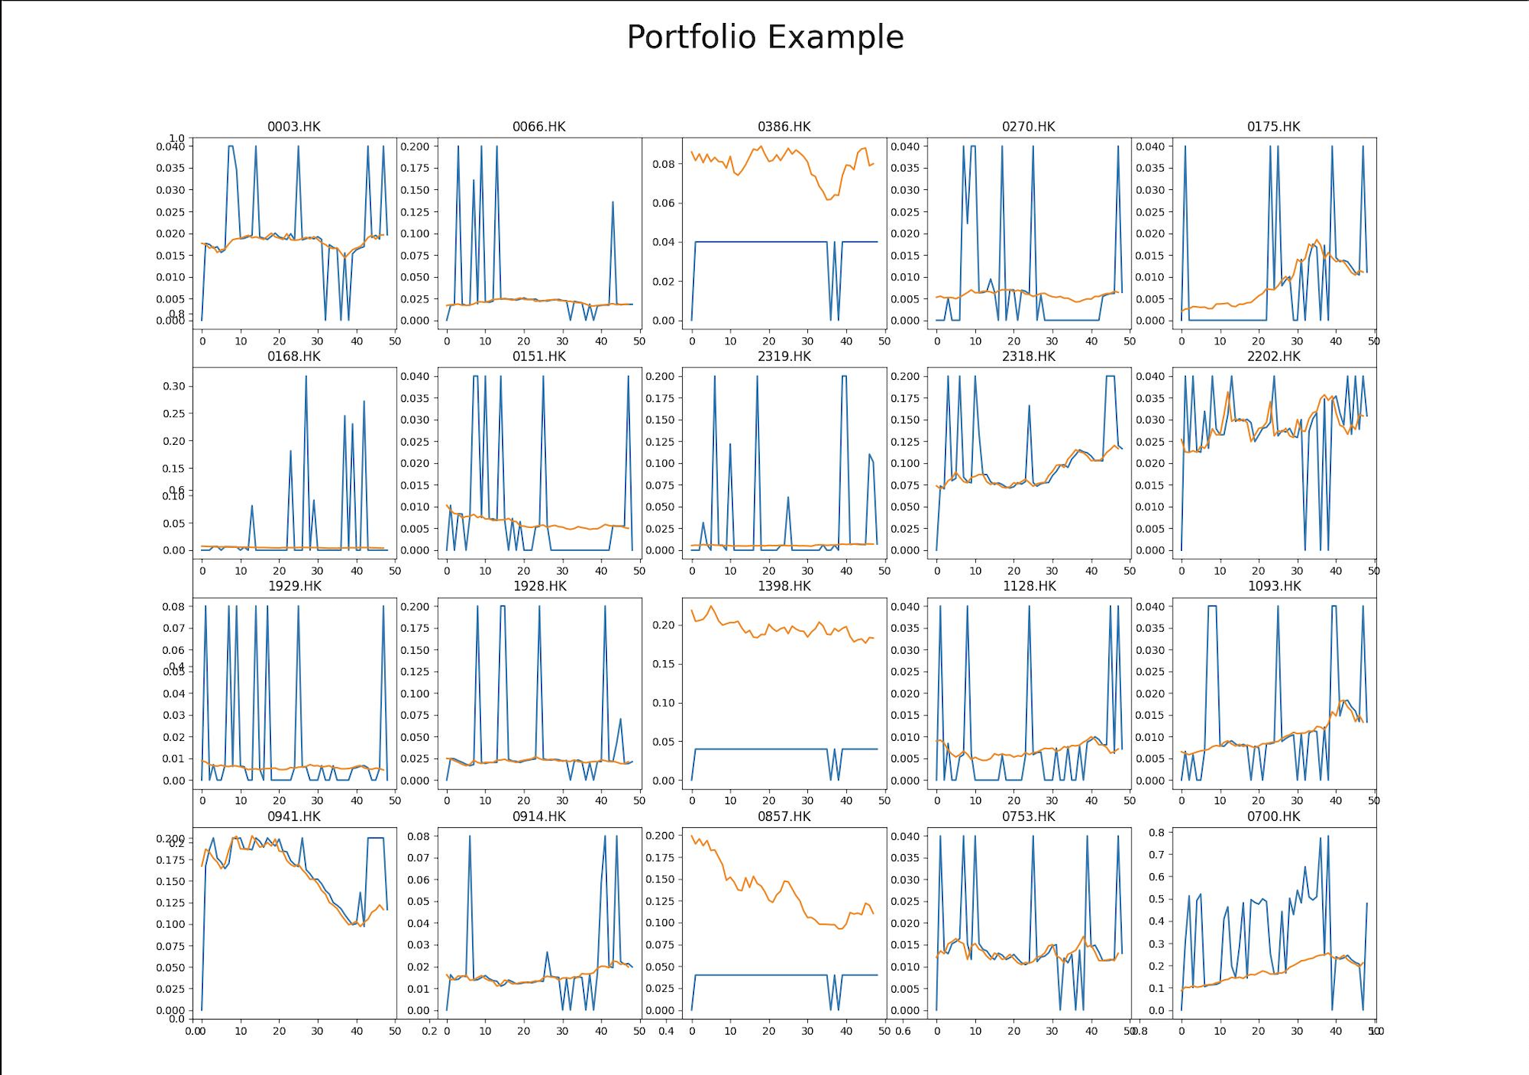
λilly and λ_{tc}
λsec
Example Portfolio
OUR
OBJECTIVE
FUNCTION

Slide 31
λsec
Example Portfolio
OUR
OBJECTIVE
FUNCTION
Thank You

